Slide 1
DHS Session John Boyd Assistant Director

Slide 2
Agenda
Priorities, Initiatives, and Significant Activities

Slide 3



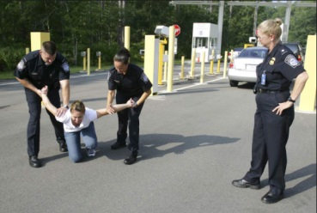
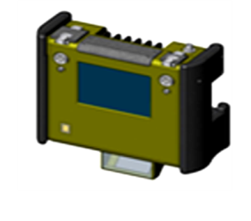
Focus on Customer Needs First
Functions
Systems Engineering
Model Behaviors
System
Modules
Intel Analyst
Business
Practices

Slide 4
Make Better Decisions
Model-based Systems Engineering
Functions
Business
Practices
System
Modules

Slide 5
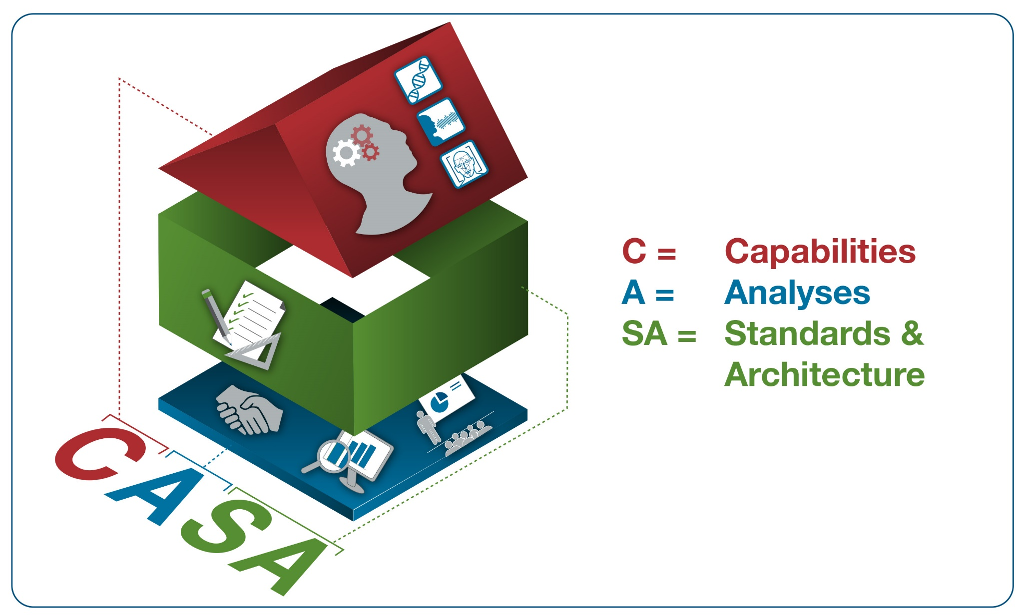
Solution Set Framework

Slide 6
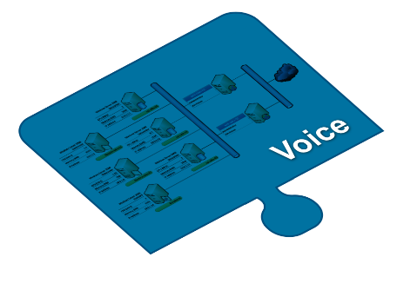
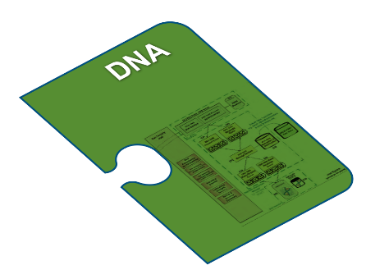

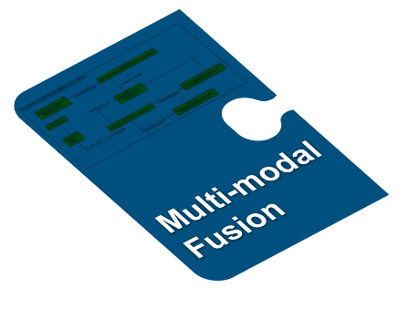
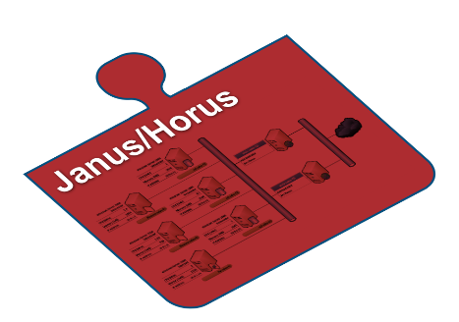



FI—Analyses, Standards & Architecture
Analyses,
Standards & Architecture
Characterize Future State of Identity
TSA/OBIM Biometric Strategy
S&T Roadmap
Integrated Architectures
Facial Recognition Concerns
Juvenile Biometrics
Standards

Slide 7
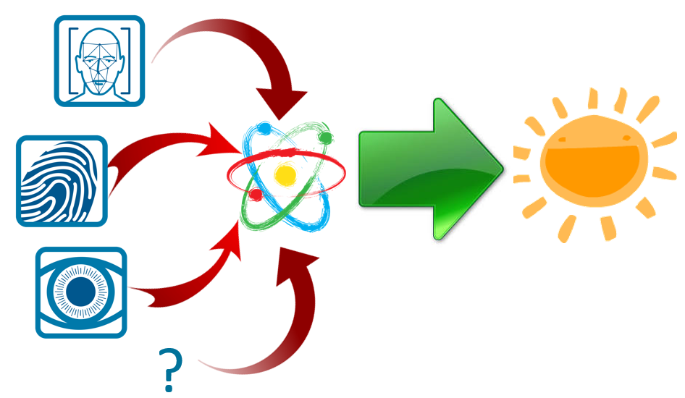


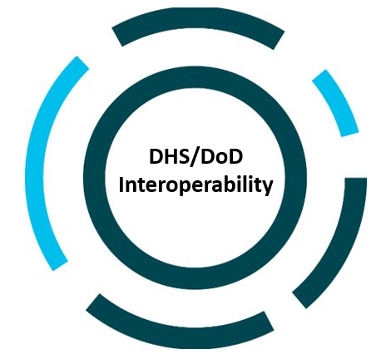





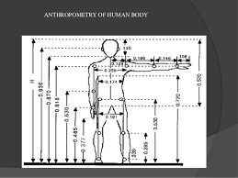

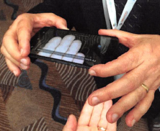
Futures Identity Projects
Forecast
Proof of Concept
Prototype
Joint Field Test
Pilot/ Production
Maturity Category
Delivery Time Frame
Long
Mid
Near
FI leverages a lightweight and efficient lifecycle process to explore capabilities
through innovation and creativity.

Slide 8


Slide 9




Identity Dominance System - Solutions-level Architecture Components
Functions
Total Delivery--Capability!
F.1 System Control
F.2 Mission Management
F.3 Subject Transfer
F.4 Subject Enrollment
F.5 User Training
Raid
Mission #3
Intel Analyst
System Modules
Operational Activities
Hardware
Software
A.1 Collect, Consolidate and Validate Identity Information
A.2 Analyze, Share, and Reference Identity Information
A.3 Act on Identity Information
Operator
Expanded Maritime
Interception Operation #5
Infrastructure

